Slide 1
INZIRA
An AI app that finds and lists the websites hosting opportunities for youth in Rwanda
“Inzira” means PATH in Kinyarwanda
By Liliane Umwanankabandi
BSc. Software Engineering · Supervisor: Samiratu Nthosi · ALU 2026

Slide 2
Outline
Introduction & the need
Data
Data exploration
Data preprocessing
System approach
System architecture
Results
Discussion
Conclusions
Liliane Umwanankabandi · ALU 2026

Slide 3
Introduction & the need
Problem: youth miss opportunities scattered across many websites — they don’t know where to look.
Youth unemployment ~23% (2018–2022); 32% not in work, school, or training (2022).
IPAR (2022): lack of information is the #1 barrier — above lack of skills.
Gaps in existing platforms (Job in Rwanda, LinkedIn, Opportunity Desk):
They list opportunities by hand — not the source websites.
Coverage is split; Opportunity Desk is global, not Rwanda-focused.
No automatic trust scoring.
No Kinyarwanda; no data shared with MIFOTRA.
Goal: automatically search the web and list the websites hosting opportunities for Rwandan youth.
Liliane Umwanankabandi · ALU 2026

Slide 4
Data
Inzira's dataset: 551 web pages scraped from Rwandan and international sources (DuckDuckGo + BeautifulSoup), manually labeled and version-controlled on GitHub. Annotator agreement: Cohen’s κ = 0.81 (strong).
Field | Description
url | source web page link
text | page content, truncated to ~400 words
bert_label | binary — opportunity (393) / not (158)
roberta_label | category — 1 of 7 opportunity types
trust features | domain, content, quality, spam signals
Outcome: for each page — is it an opportunity, which category, and a trust score.
Liliane Umwanankabandi · ALU 2026

Slide 5
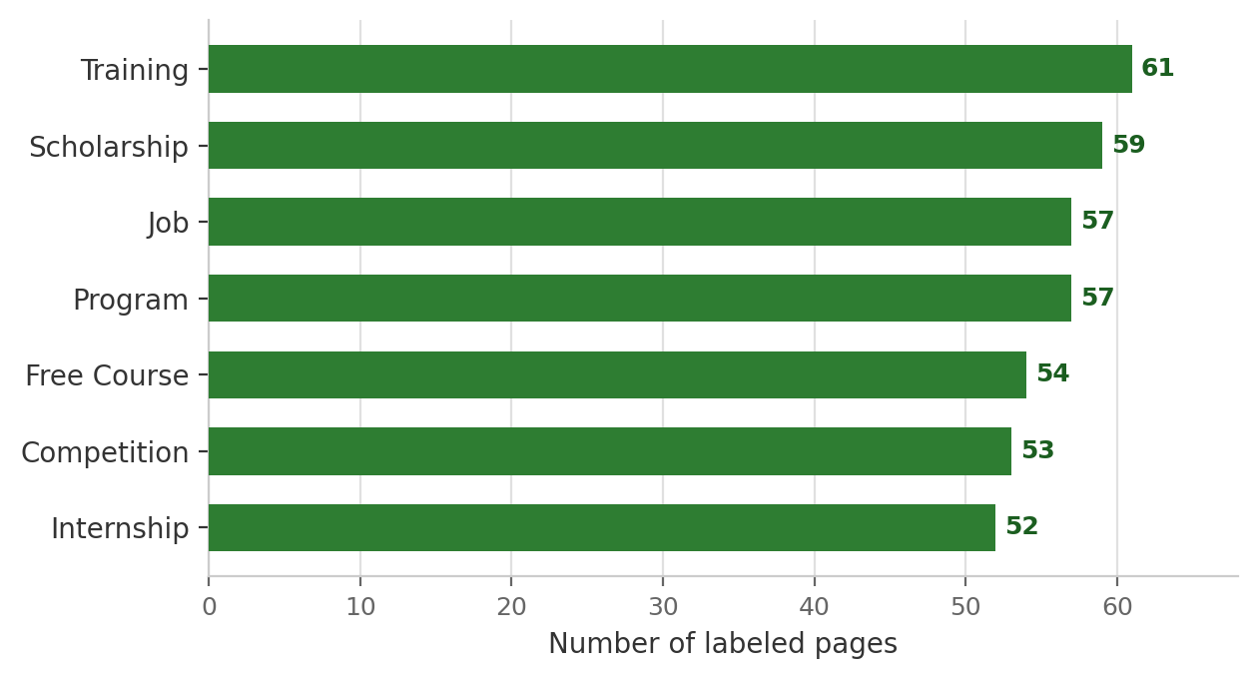
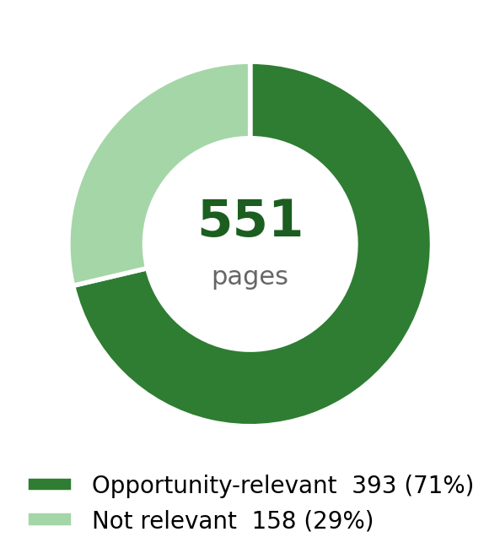
Data exploration
Figure: categories are balanced (52–61 pages); binary labels are imbalanced (71% / 29%) → handled with SMOTE.
Liliane Umwanankabandi · ALU 2026

Slide 6
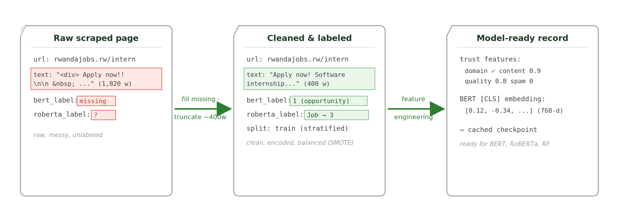
Data preprocessing
Figure: Inzira preprocessing — a raw scraped page becomes a clean, labeled, feature-rich record (done in Google Colab).
Liliane Umwanankabandi · ALU 2026

Slide 7
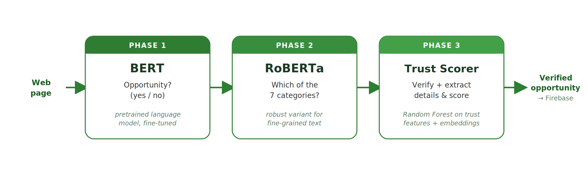
System approach
Three different tasks — so three models work in sequence:
Why these models: transformers (BERT, RoBERTa) give rich text understanding; Random Forest is fast and interpretable for trust scoring.
Trained in Google Colab (GPU) · PyTorch · Transformers · scikit-learn · AdamW + warmup · gradient clipping · checkpointing
Liliane Umwanankabandi · ALU 2026

Slide 8
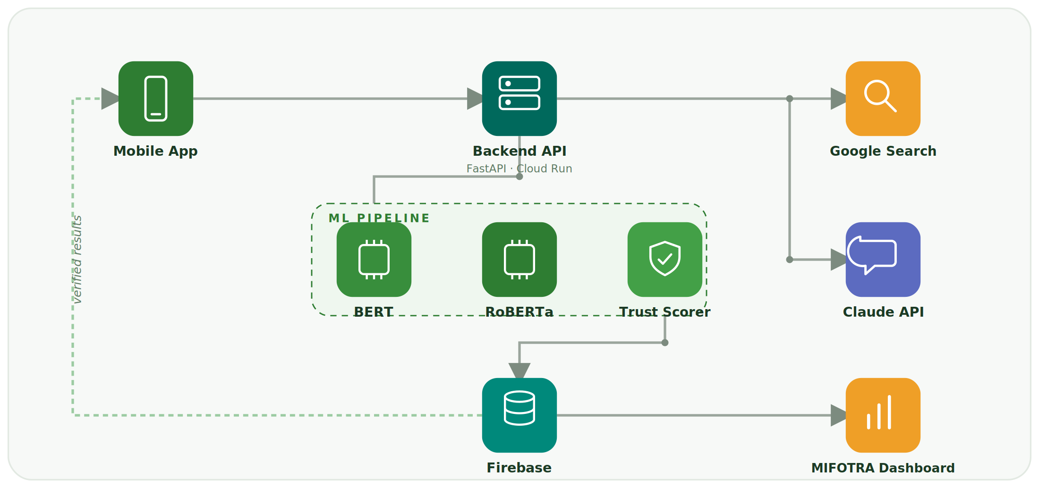
System architecture
Liliane Umwanankabandi · ALU 2026

Slide 9
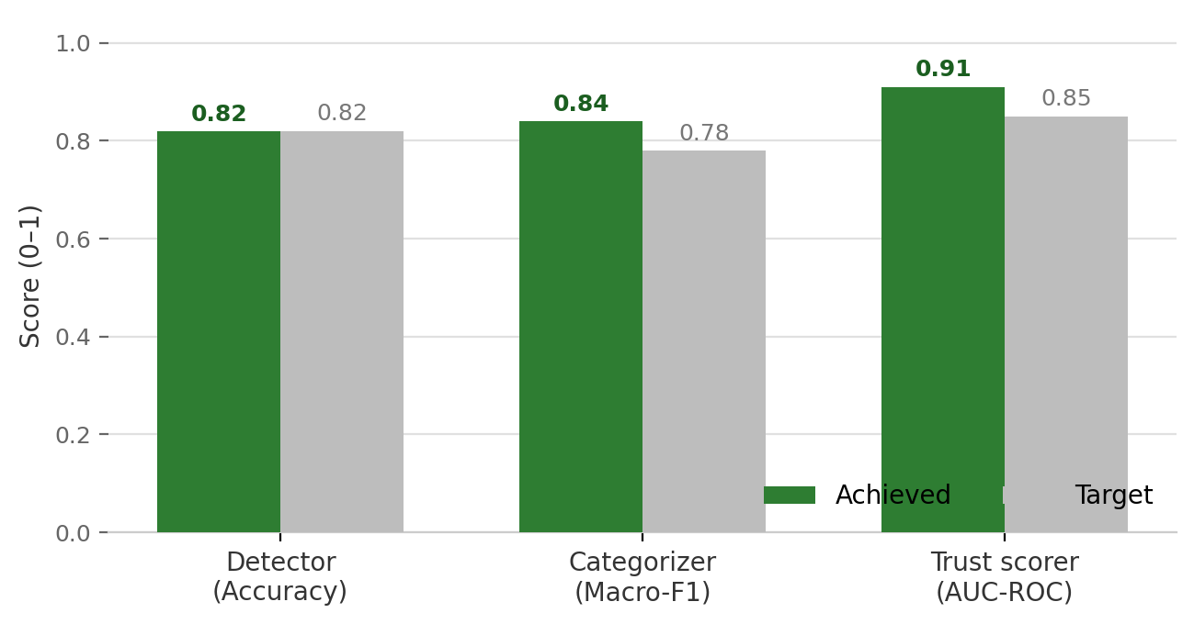
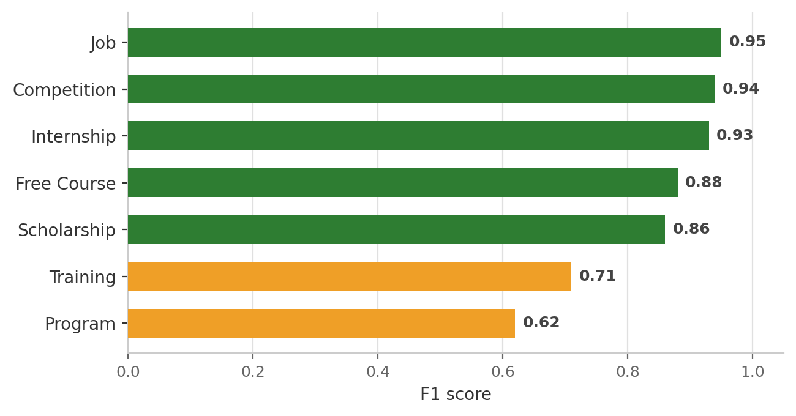
Results
Achieved vs target
Category F1 (RoBERTa)
Two targets met; detector essentially at target. Strong on jobs & competitions; “program” overlaps other types. Usability test (40 youth, Kigali) upcoming.
Liliane Umwanankabandi · ALU 2026

Slide 10
Discussion
Three models — three different tasks; one model can’t do all well.
Transfer learning — a focused dataset is enough; results (0.84, 0.91) confirm it.
Search-driven beats recommendation — opportunities expire fast.
Unique: lists hosting websites, supports Kinyarwanda, and feeds MIFOTRA analytics.
Liliane Umwanankabandi · ALU 2026

Slide 11
Conclusions & future work
Conclusions
First platform to search the web and list the websites hosting opportunities.
Models trained and tested — targets met.
English + Kinyarwanda; analytics for MIFOTRA.
Future work
Build the app and connect it to the trained models.
Run the Kigali pilot, then deploy nationally.
Partnerships with MIFOTRA, RDB, and WDA.
Liliane Umwanankabandi · ALU 2026

